Slide 1
LOCAL POSITIONING
FORMATION CONTROL
Ultrasonic Sensors
Local Trilateration
Route Table
Algorithms
Localization
Timer
State Estimator
Formation Control
Agent
Dynamics
Acc. Sensors
State Propogation
Gyro Sensors
Mag. Sensors
Formation
Shape

Slide 2
LOCAL POSITIONING
Ultrasonic Sensors
Local Trilateration
Route Table
Algorithms
Localization
Timer
Acc. Sensors
State Estimator
State Propogation
True Position&Velocity
Information
Gyro Sensors
Mag. Sensors

Slide 4
3
5
4
6
1
2
7
8

Slide 5
Desired Formation
Shape

Slide 6
Virtual Structure
3
1
3
3
5
Relative
Error
4
2
6
4
1
2
7
8
5
8
7
6

Slide 7
Position
Beacon

Slide 8
 | Iteration
Node | 0 | 1 | 2 | 3 | 4 | 5 | 6 | 7
S | 0 | 0 | 0 | 0 | 0 | 0 | 0 | 0
A | ∞ | 10 | 10 | 5 | 5 | 5 | 5 | 5
B | ∞ | ∞ | ∞ | 10 | 6 | 5 | 5 | 5
C | ∞ | ∞ | ∞ | ∞ | 11 | 7 | 6 | 6
D | ∞ | ∞ | ∞ | ∞ | ∞ | 14 | 10 | 9
E | ∞ | ∞ | 12 | 8 | 7 | 7 | 7 | 7
F | ∞ | ∞ | 9 | 9 | 9 | 9 | 9 | 9
G | ∞ | ∞ | 8 | 8 | 8 | 8 | 8 | 8
S
10
8
A
1
G
B
-4
1
1
2
-2
C
F
D
3
-1
E
-1

Slide 9
Routing Loop Problem
(D,6)
(D,4)
(D,4)
(D,4)
(D,2)
(D,2)
A
B
C
D
Dest. | Next | Metric
… | … | …
D | B | 3, 5, …
Dest. | Next | Metric
… | … | …
D | B | 2, 4, …
Dest. | Next | Metric
… | … | …
D | C | 1, 3, 5,..

Slide 10
Route table for agent 2
Destination | Next Hop | Metric | Dest. Seq. No
1 | 1 | 1 | 123
3 | 3 | 1 | 516
4 | 4 | 1 | 212
5 | 4 | 2 | 168
6 | 8 | 3 | 372
7 | 8 | 2 | 432
3
5
4
6
1
2
7
8

Slide 11
DSDV Link Addition
C
A
B
E
D
DSDV Link Breaks
C
A
B
E
D

Slide 12
Return to Home Approach
Lost agent aims to
arrive to this point
Movement in real world
Agent’s real
position
Agent’s wrong
position
Estimated movement to
the formation center

Slide 13
FORMATION CONTROL
Potential Field
Based Approach
Shape Partitioning
Based Approaches
Artificial Forces Method
Bubble Packing Method
Randomized Fractals Method

Slide 14
A simple closed curve

Slide 15
İceride dısarıda noktaları gosteren sekıl

Slide 16
Coverage Circles

Slide 17
Attractive Forces

Slide 18
Obstacle Forces
Obstacle

Slide 19
Repulsive Forces

Slide 20
Intermember Forces

Slide 22

0
Gain
0
Gain
Outside of the Formation Shape
Inside of the Formation Shape
Distance
Distance

Slide 25
Initial Placement
First Iteration
Goal States

Slide 26
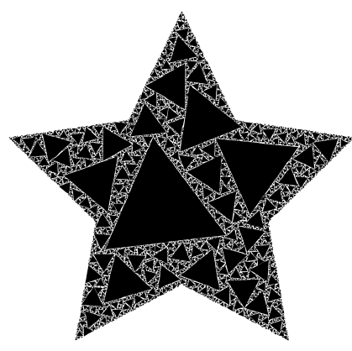
Randomized Fractals

Slide 27
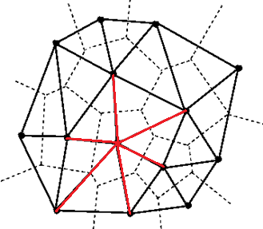
Node i with 6 neighbors
Node i

Slide 28
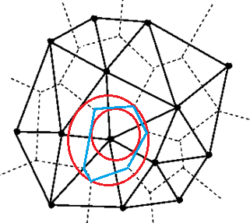
The inscribed and circumscribing circles of Voronoi cell belonging to Node i
Node i
Voronoi Cell
of Node i

Slide 29



Goal State
Position
System
Output
Velocity Setpoint Generator
Controller
Plant

Slide 30
Goal State
Amplitude
Bearing Angle
Agent

Slide 31
r
+
+
u
y
1/s
Plant
-
+

Slide 32
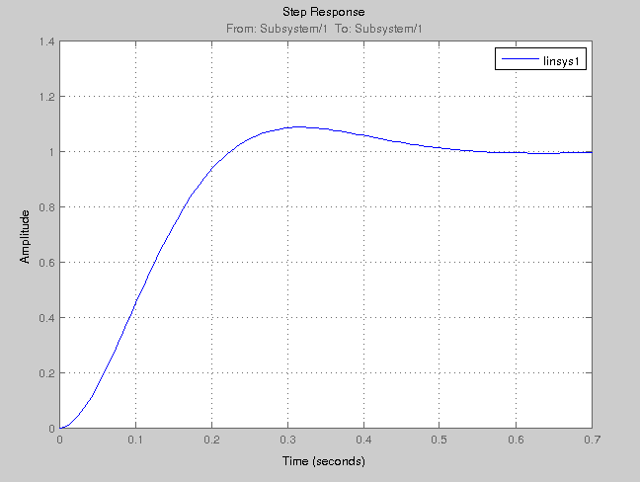

Slide 33
GAZEBO
Goal States
Publisher Interface
Model1
Plugin
Model2
Plugin
....
Modeln
Plugin
MATLAB
Physics Engine
A1
A2
....
An
Gazebo Publisher
Matlab Listener
Formation Shape
Agent State Vectors

Slide 34
Üc farklı tip agent ve ortamı gösteren gazebo resmi

Slide 35
Hardware Implementation
Mesh Network
CPU
Radio Link
Actuators
Visual Feedback
MATLAB
Shape Partitioning Algorithms
Image Processing Algorithms
Agent 1
CPU
Radio Link
Actuators
CPU
Radio Link
Position Feedback
Potential Goal States
Agent 2
Actuators
E/O
Camera
Radio Link
Agent 5
Mission Computer
CPU
Radio Link
Actuators
Agent 3
CPU
Radio Link
Actuators
Agent 4

Slide 36
Single Agent
Microchip Pic16f690
Controller Unit
Shuncom SZ05-ADV
Radio Link
Telemetry
UART
Telecommand
Motor Control
Commands
Motor Control
Commands
Motor Control
Commands
GPIO
GPIO
GPIO
ULN2003APG
Step Motor
Controller
ULN2003APG
Step Motor
Controller
ULN2003APG
Step Motor
Controller
Motor 1
Motor 2
Motor 3

Slide 37
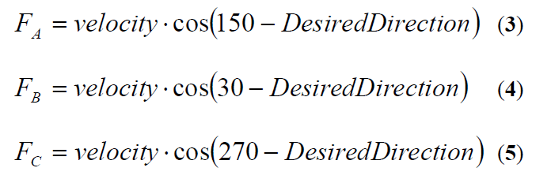
Command Mixture for 3 Wheel Omni Directional Mobile Robots
Wheel A
Desired
Direction
α
Wheel’s Positive
Turn Direciton
Wheel B
Wheel C

Slide 38
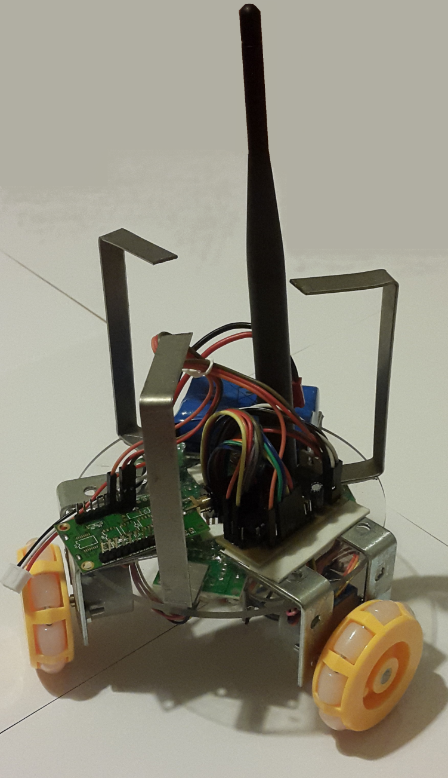
Hardware-1
Antenna
Control
Board
Battery
Radio
Link
Omni - Wheels

Slide 39
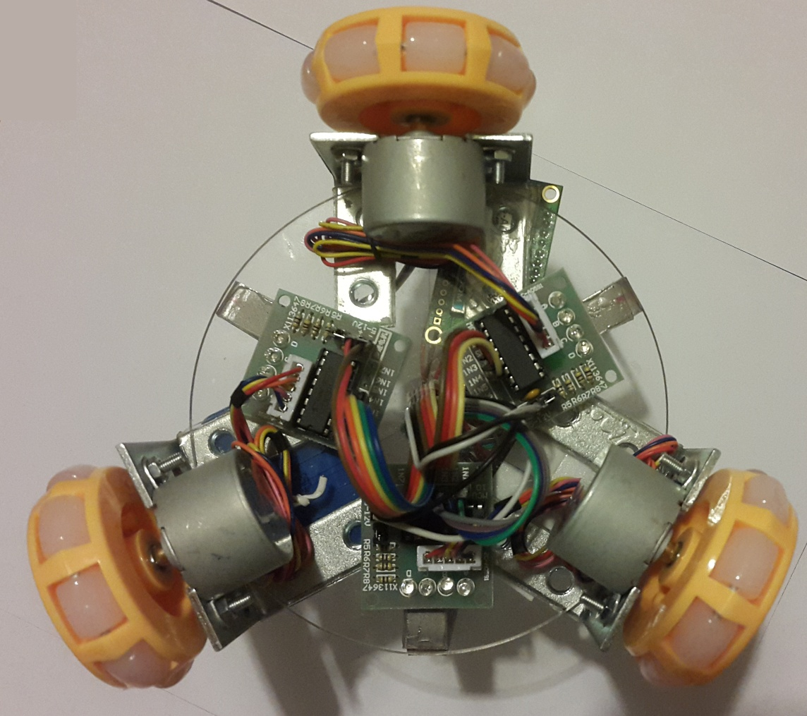
Hardware-2
Stepper
Motor
Stepper
Motor
Controller
Omni
Wheel

Slide 40
Beacons with
known positions
Unknown Position
of an Agent

